Slide 1
Data Structure
Soumi Dutta, IEM

Slide 2
PRE ORDERS TRAVERSAL RECURSIVELY
To traverse a non-empty binary tree in pre order following steps one to be processed
1. Visit the root node
2. Traverse the left sub tree in preorder
3. Traverse the right sub tree in preorder
That is, in preorder traversal, the root node is visited (or processed) first, before traveling through left and right sub trees recursively. It can be implement in C/C++ function as below :
void preorder (Node * Root)
{
If (Root != NULL)
{
printf (“%d\n”,Root → Info);
preorder(Root → L child);
preorder(Root → R child);
}
}

Slide 3
IN ORDER TRAVERSAL RECURSIVELY
The in order traversal of a non-empty binary tree is defined as follows :
1. Traverse the left sub tree in order
2. Visit the root node
3. Traverse the right sub tree in order
In order traversal, the left sub tree is traversed recursively, before visiting the root. After visiting the root the right sub tree is traversed recursively, in order fashion. The procedure for an in order traversal is given below :
void inorder (NODE *Root)
{
If (Root != NULL)
{
inorder(Root → L child);
printf (“%d\n”,Root → info);
inorder(Root → R child);
}
}

Slide 4
POST ORDER TRAVERSAL RECURSIVELY
The post order traversal of a non-empty binary tree can be defined as :
1. Traverse the left sub tree in post order
2. Traverse the right sub tree in post order
3. Visit the root node
In Post Order traversal, the left and right sub tree(s) are recursively processed before
visiting the root.
void postorder (NODE *Root)
{
If (Root != NULL)
{
postorder(Root → Lchild);
postorder(Root → Rchild);
printf (“%d\n”,Root à info);
}
}

Slide 5
BINARY SEARCH TREES
A Binary Search Tree is a binary tree, which is either empty or satisfies the following properties :
1. Every node has a value and no two nodes have the same value (i.e., all the values are unique).
2. If there exists a left child or left sub tree then its value is less than the value of the root.
3. The value(s) in the right child or right sub tree is larger than the value of the root node.
struct NODE
{
int Info;
struct NODE *Left_Child;
struct NODE *Right_Child;
};

Slide 6
BINARY SEARCH TREES
struct NODE * Create_Tree (int Info, struct NODE *Node)
{
if (Node == NULL)
{
Node = (struct NODE *) malloc( sizeof(struct NODE ));
Node->Info = Info;
Node->Left_Child = NULL;
Node->Right_Child = NULL;
return (Node);
}
if (Node->Info >= Info )
Node->Left_Child = Create_Tree (Info, Node->Left_Child);
else
Node->Right_Child = Create_Tree (Info, Node->Right_Child);
return(Node);
}

Slide 7
INSERTING A NODE ALGORITHM
NEWNODE is a pointer variable to hold the address of the newly created node. DATA is the information to be pushed.
1. Input the DATA to be pushed and ROOT node of the tree.
2. NEWNODE = Create a New Node.
3. If (ROOT == NULL)
(a) ROOT=NEW NODE
4. Else If (DATA < ROOT -> Info)
(a) ROOT = ROOT -> Lchild
(b) GoTo Step 4
5. Else If (DATA > ROOT -> Info)
(a) ROOT = ROOT -> Rchild
(b) GoTo Step 4

Slide 8
INSERTING A NODE ALGORITHM
6. If (DATA < ROOT -> Info)
(a) ROOT -> LChild = NEWNODE
7. Else If (DATA > ROOT -> Info)
(a) ROOT -> RChild = NEWNODE
8. Else
(a) Display (“DUPLICATE NODE”)
(b) EXIT
9. NEW NODE -> Info = DATA
10. NEW NODE -> LChild = NULL
11. NEW NODE -> RChild = NULL
12. EXIT

Slide 9
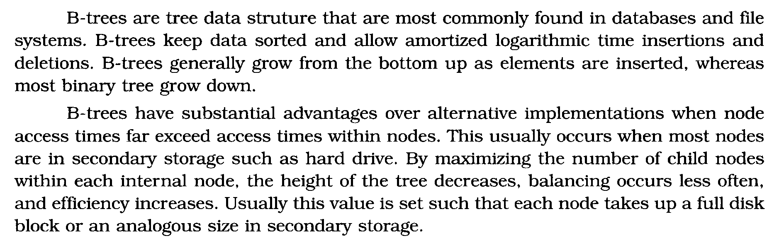

B Tree
Nodes in a B-Tree are usually represented as an ordered set of elements and child pointers. Every node but the root contains a minimum of m elements, a maximum of n elements, and a maximum of n + 1 child pointers, for some arbitrary m and n. For all internal nodes, the number of child pointers is always one more than the number of elements. Since all leaf nodes are at the same height, nodes do not generally contain a way of determining whether they are leaf or internal.

Slide 10
B-Tree(Example: order 5)
Nodes : a, g , f, b, k, d, h, m, j, e, s, i, r, x, c, l, n, t, u, p
Insert a :
a
Insert g :
a, g
Insert f :
a, f, g
Insert b :
a, b, f, g
Insert k :
f
a, b
g, k

Slide 11
B Tree(Example: order 5)
Nodes : a, g , f, b, k, d, h, m, j, e, s, i, r, x, c, l, n, t, u, p
Insert d :
f
a, b, d
g, k
Insert h :
f
a, b, d
g, h, k
Insert m:
f
a, b, d
g, h, k, m

Slide 12
B Tree(Example: order 5)
Nodes : a, g , f, b, k, d, h, m, j, e, s, i, r, x, c, l, n, t, u, p
Insert j :
f, j
a, b, d
g, h
k, m
Insert e, s, i, r, x :
f, j, r
a, b, d, e
g, h, i
k, m
s, x
Insert c, l, n, t, u :
f, j, r
a, b, c, d, e
g, h, i
k, l, m, n
s, t, u, x

Slide 13
B Tree(Example: order 5)
Nodes : a, g , f, b, k, d, h, m, j, e, s, i, r, x, c, l, n, t, u, p
Insert c, l, n, t, u :
c, f, j, r
a, b
d, e
g, h, i
k, l, m, n
s, t, u, x
Insert p :
j
c, f
m, r
a, b
d, e
g, h, i
k, l
n, p
s, t, u, x

Slide 14
B Tree(Example: order 4)
Nodes : 84, 82, 29, 99, 65, 12, 50, 28, 58, 71, 92, 75, 79, 19, 55
Insert 84 :
84
Insert 82 :
82, 84
Insert 29 :
29, 82, 84
Insert 99 :
82
29
84, 99
Insert 65 , 12:
82
12, 29, 65
84, 99

Slide 15
B Tree(Example: order 4)
Nodes : 84, 82, 29, 99, 65, 12, 50, 28, 58, 71, 92, 75, 79, 19, 55
Insert 50:
29, 82
12
50, 65
84, 99
Insert 28, 58:
29, 82
12, 28
50, 58, 65
84, 99
Insert 71:
29, 58, 82
12, 28
50
65, 71
84, 99

Slide 16
B-Tree(Example: order 4)
Nodes : 84, 82, 29, 99, 65, 12, 50, 28, 58, 71, 92, 75, 79, 19, 55
Insert 92:
29, 58, 82
12, 28
50
65, 71
84, 92, 99
Insert 75:
29, 58, 82
12, 28
50
65, 71, 75
84, 92, 99
Insert 79:
29, 58, 71, 82
12, 28
50
65
75, 79
84, 92, 99

Slide 17
B-Tree(Example: order 4)
Nodes : 84, 82, 29, 99, 65, 12, 50, 28, 58, 71, 92, 75, 79, 19, 55
Insert 79:
58
29
71, 82
12, 28
50
65
75, 79
84, 92, 99

Slide 18
B-Tree(Example: order 4)
Nodes : 84, 82, 29, 99, 65, 12, 50, 28, 58, 71, 92, 75, 79, 19, 55
58
Insert 19:
29
71, 82
12, 19, 28
50
65
75, 79
84, 92, 99
Insert 55:
58
29
71, 82
12, 19, 28
50, 55
65
75, 79
84, 92, 99

Slide 19
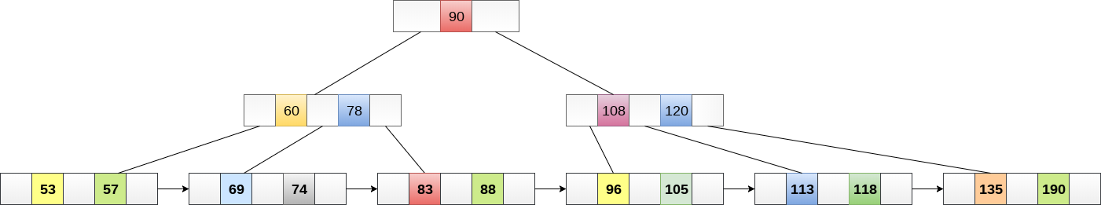
B+ Tree
B+ Tree is an extension of B Tree which allows efficient insertion, deletion and search operations.
In B Tree, Keys and records both can be stored in the internal as well as leaf nodes. Whereas, in B+ tree, records (data) can only be stored on the leaf nodes while internal nodes can only store the key values.
The leaf nodes of a B+ tree are linked together in the form of a singly linked lists to make the search queries more efficient.
B+ Tree are used to store the large amount of data which can not be stored in the main memory. Due to the fact that, size of main memory is always limited, the internal nodes (keys to access records) of the B+ tree are stored in the main memory whereas, leaf nodes are stored in the secondary memory.
The internal nodes of B+ tree are often called index nodes. A B+ tree of order 3 is shown in the following figure.

Slide 20

Advantages of B+ Tree
Records can be fetched in equal number of disk accesses.
Height of the tree remains balanced and less as compare to B tree.
We can access the data stored in a B+ tree sequentially as well as directly.
Keys are used for indexing.
Faster search queries as the data is stored only on the leaf nodes.

Slide 21
B Tree VS B+ Tree
SN | B Tree | B+ Tree
1 | Search keys can not be repeatedly stored. | Redundant search keys can be present.
2 | Data can be stored in leaf nodes as well as internal nodes | Data can only be stored on the leaf nodes.
3 | Searching for some data is a slower process since data can be found on internal nodes as well as on the leaf nodes. | Searching is comparatively faster as data can only be found on the leaf nodes.
4 | Deletion of internal nodes are so complicated and time consuming. | Deletion will never be a complexed process since element will always be deleted from the leaf nodes.
5 | Leaf nodes can not be linked together. | Leaf nodes are linked together to make the search operations more efficient.

Slide 22
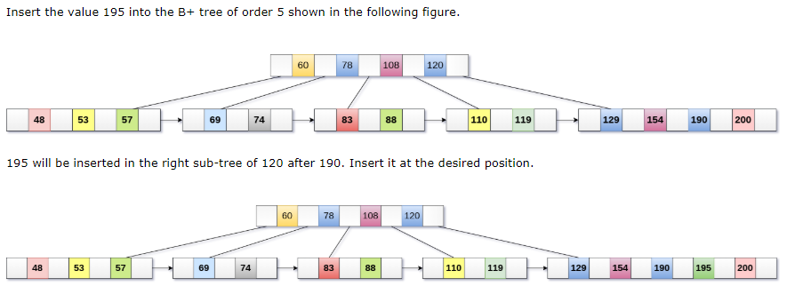
Insertion in B+ Tree
Step 1: Insert the new node as a leaf node
Step 2: If the leaf doesn't have required space, split the node and copy the middle node to the next index node.
Step 3: If the index node doesn't have required space, split the node and copy the middle element to the next index page.
Example :

Slide 23
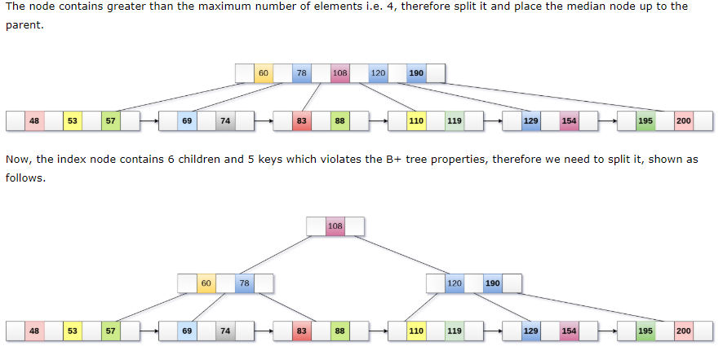
Insertion in B+ Tree

Slide 24
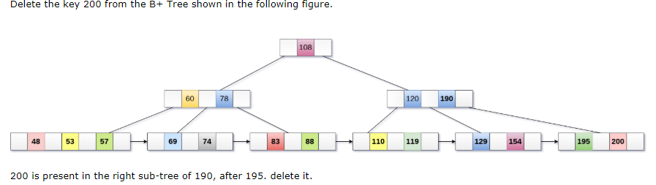
Deletion in B+ Tree
Step 1: Delete the key and data from the leaves.
Step 2: if the leaf node contains less than minimum number of elements, merge down the node with its sibling and delete the key in between them.
Step 3: if the index node contains less than minimum number of elements, merge the node with the sibling and move down the key in between them.
Example

Slide 25
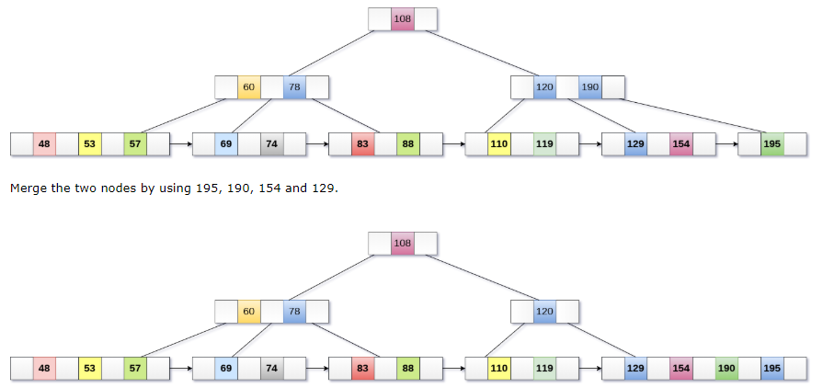
Deletion in B+ Tree

Slide 26

Deletion in B+ Tree
Now, element 120 is the single element present in the node which is violating the B+ Tree properties. Therefore, we need to merge it by using 60, 78, 108 and 120.
Now, the height of B+ tree will be decreased by 1.

